Slide 1
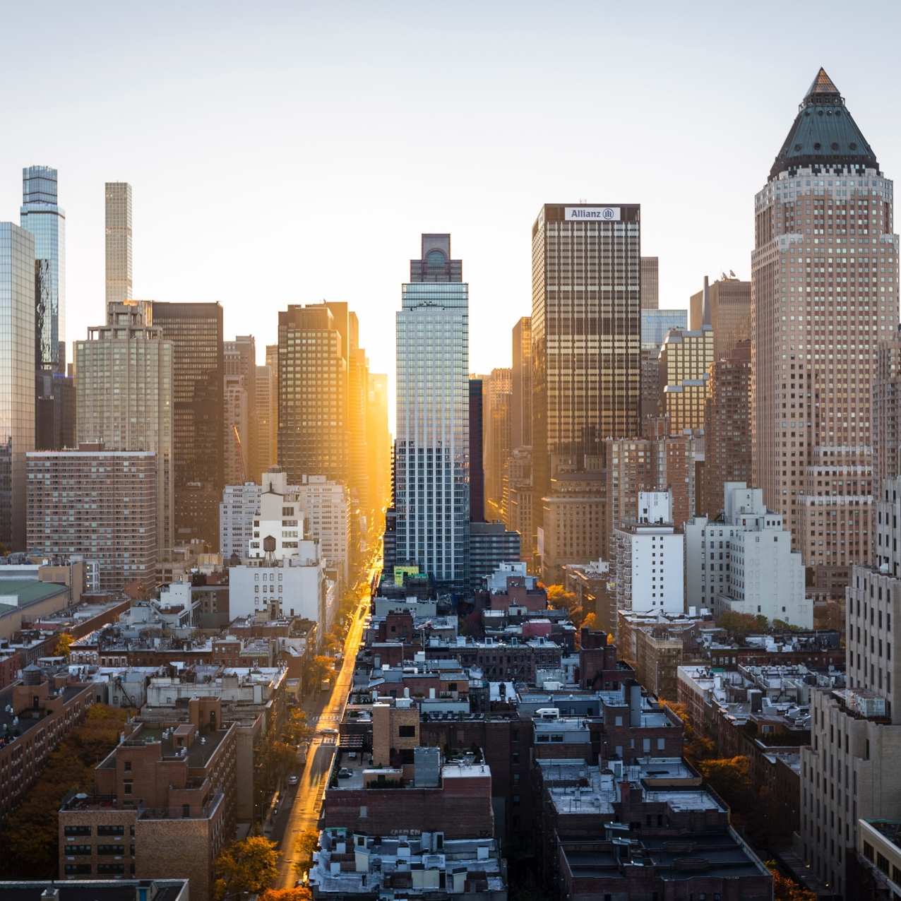
DEPLOYING COMMERCIAL PLAN IN CALIFORNIA
Applied Data Science Capstone course
Final Report
Michael Touati
April 2019

Slide 2
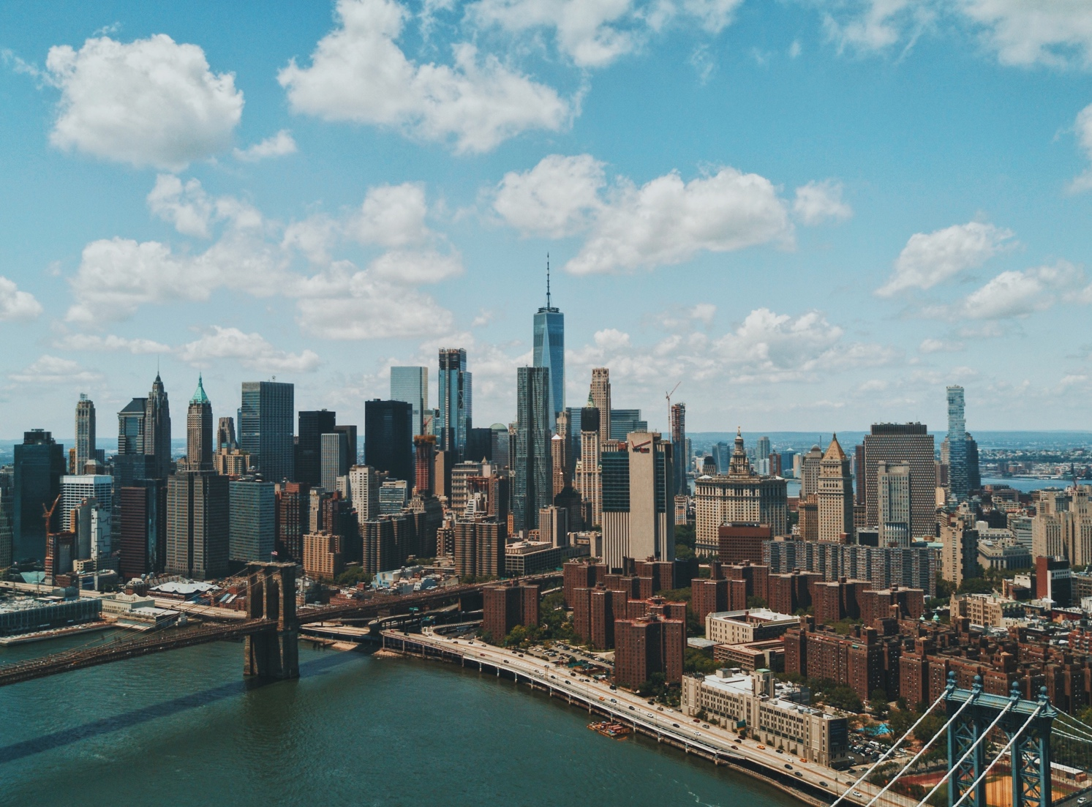
Objective
Provide support to the executive team to choose the best mall locations to deploy CarmenUp commercial booths under viability and best valuation conditions

Slide 3

Carmenup company
CarmenUp is a large company providing senior and elder care products for home health care equipment and assistive devices for aging parents and caregivers.
The company is a full-service home medical equipment firm that uses tailored products and services to empower patients to live their fullest lives.
The company is well established in Nevada and Arizona states and now has identify a high potential of growth in the neighboring state of California.
.

Slide 4
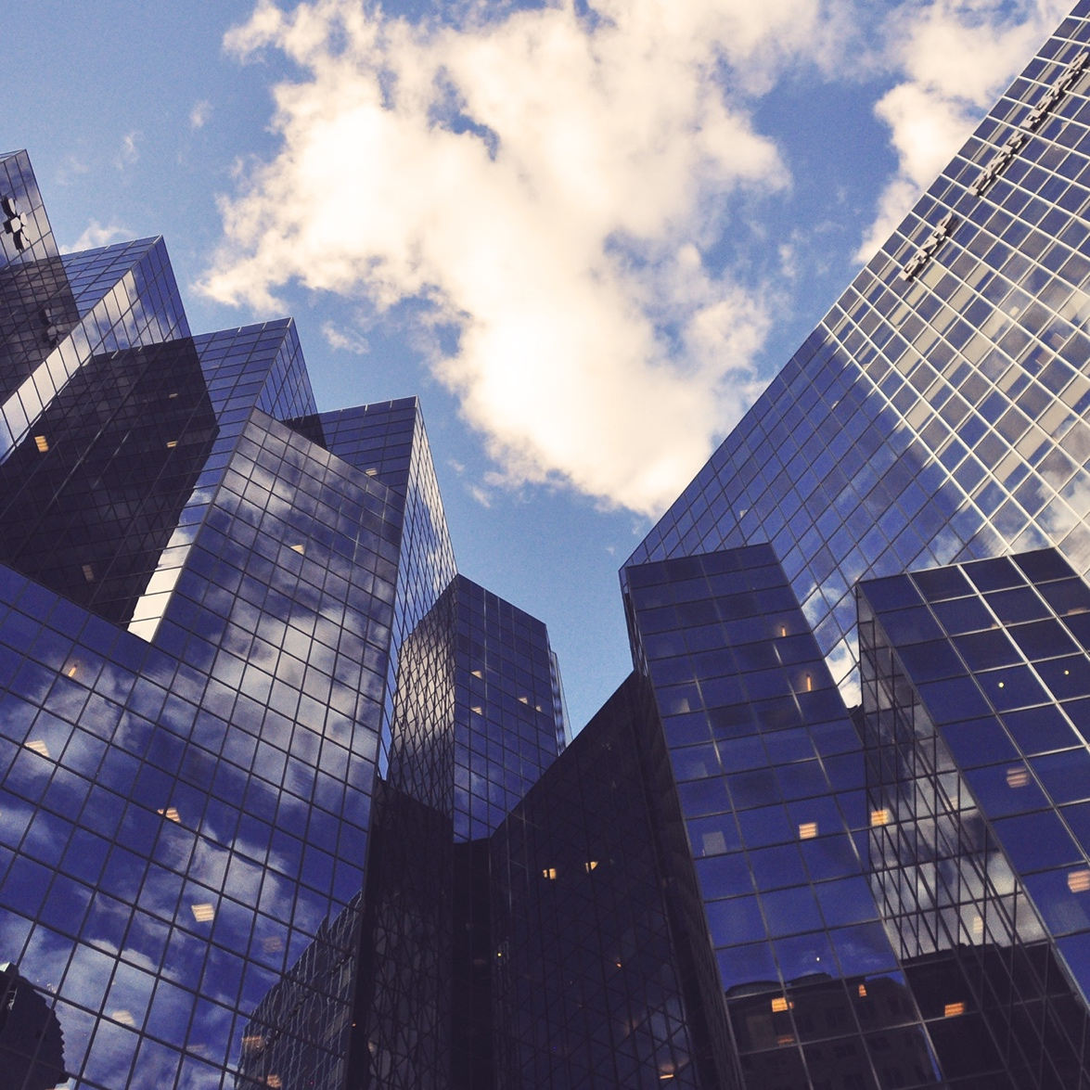
Business problem
To solve this business problem, we are going to isolate California's cities and neighborhoods with wealthiest population and high potential of interest for CarmenUp products and services. Then, we will define a list of the closest public shopping malls around these best potential areas.
Our final output will be a synthesis report with a recommendation to implement booths in the 20 highest-potential malls in California.

Slide 5
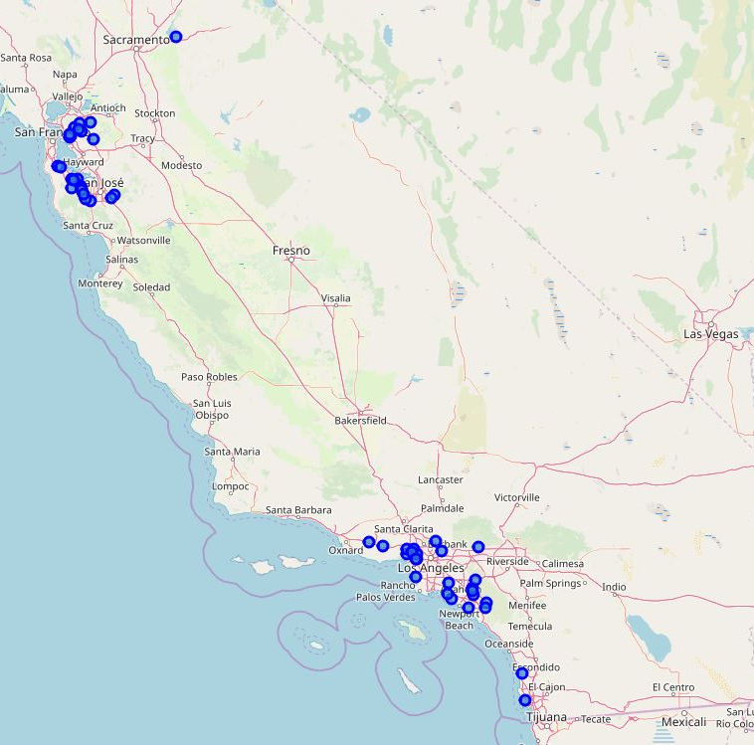


Data collection
Main dataset
Foursquare api
Dataset collected from the Kaggle website.
The full data represents more than 32000 neighborhoods in USA with geolocation and income data.
Our dataset consists of state name, city, neighborhood id, geographic coordinates, values for average households' income in 2017 and many other information.
We use Foursquare API to get venues information close to geographic coordinates.
We extract shopping malls locations in the close vicinity of our location candidates.

Slide 6
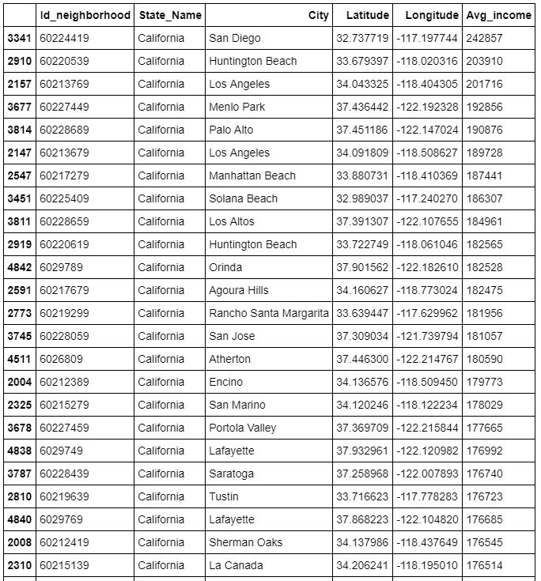

methodology
Identify best locations
Extract the best location in California based on the highest average income data in the Sate.
Clustering the location points to limit proximity of clusters.
Creating map of the 20 best candidates.

Slide 7
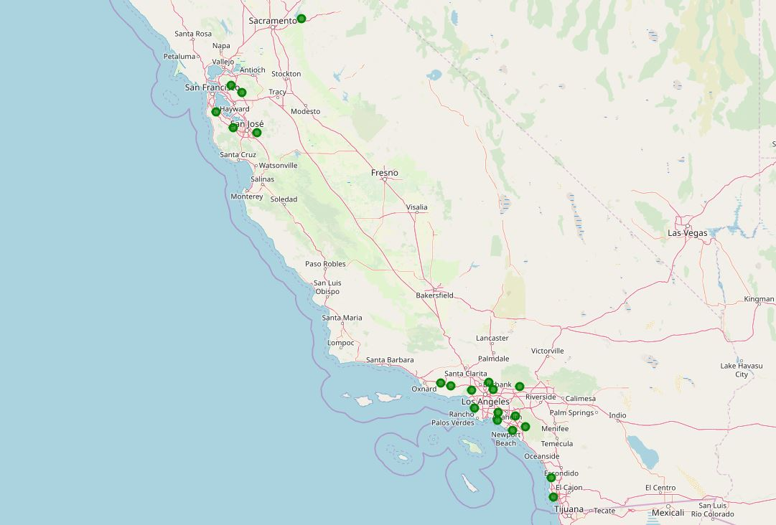
Mapping the 20 best candidates

Slide 8
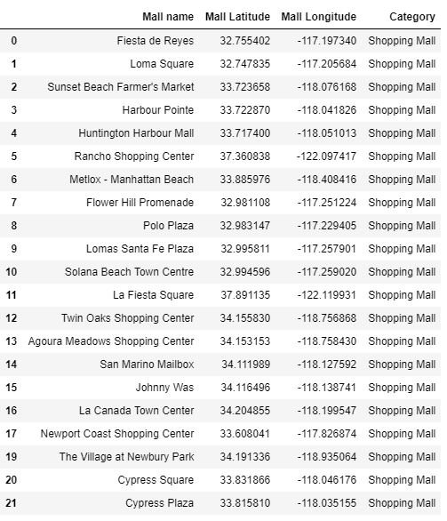
Identify shopping malls in the vicinity
Foursquare data
Request API to find closest shopping malls
Remove irrelevant results.
Creating map of the 22 best malls locaions.

Slide 9
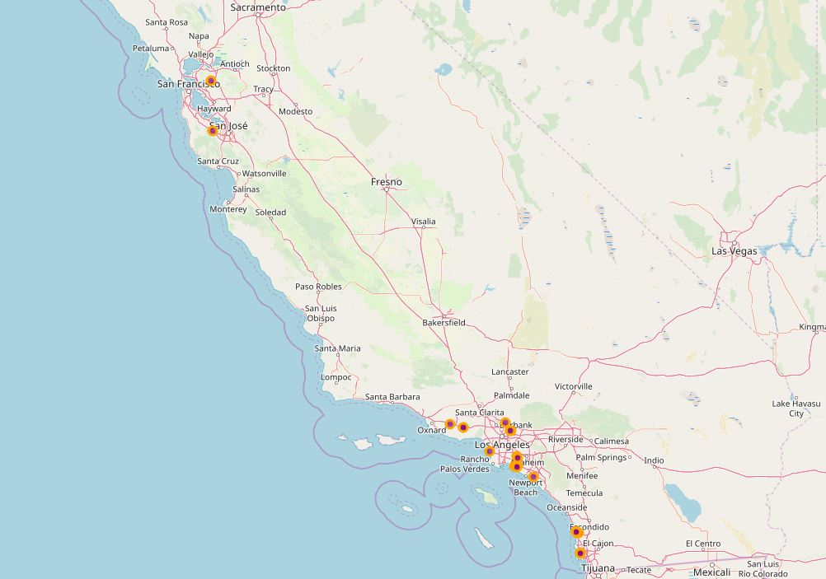
Mapping the 22 best shopping mall locations

Slide 10
results
We clearly identified 22 location malls. There are three main areas for commercial expansion in California:
San Francisco Bay in the North (2 shopping malls identified);
The coastal strip from Thousand Oaks to Newport Beach in the Los Angeles region (14 shopping malls identified);
Southern coastal strip from Solana Beach to San Diego (6 shopping malls identified).

Slide 11
discussion
Based on the results, we recommend concentrating the commercial expansion effort on the Los Angeles area that includes 64% of the identified best locations (14 into 22 malls).
Such a recommendation should ensure economies of scale in planning and effective commercial costs, as well as optimal resource saving.
Complementary reports could explore each mall in depth and access Foursquare reviews, photos, and tips to identify the best booth location inside the shopping mall.
Using client-friendly and intuitive tools and open access data on the Internet we successes to offer a solution for channeling efforts and investments, minimize entry costs and maximize potential profit.

Slide 12
conclusion
Starting from an extremely wide area of 423 970 km² (the all state of California), our machine-learning approach allows us to create a complete ready-to-use commercial deployment plan under uncertainty conditions.
The main task was to minimize the risks of business failure under an established plan of targeting new clients in a whole state of the USA.
It is important to emphasize that the present model is built in an open-source and upscaling approach such that it is completely open to offer solution for rollout in any state in the United States and even can be used in a much closer resolution.
Moreover, this machine-learning guidebook is adaptable to other sources of data, future updates and changes in configuration.

Slide 13

Thank you
Flora@contoso.com
http://www.contoso.com/

